Slide 1

Introduction to Android

Slide 2
Expected Attitude
High self-learning
Professional
Disciplinary
You are equipped with Mobile Development Environment
You successfully completed your games
You are senior students

Slide 3
Assignment 2
An Android Application
Will be introduced in week 8
Students need to complete the application proposal to meet certain standards to get approval for development

Slide 4
Lecture overview
Android Structure
Android IDE Installation
Hello World Example

Slide 5
Where we are?
Android Structure
Android IDE Installation
Hello World Example

Slide 6
Android Structure
An Android system is a stack of software components. Linux 2.6 at the bottom (approximately 115 patches)

Slide 7
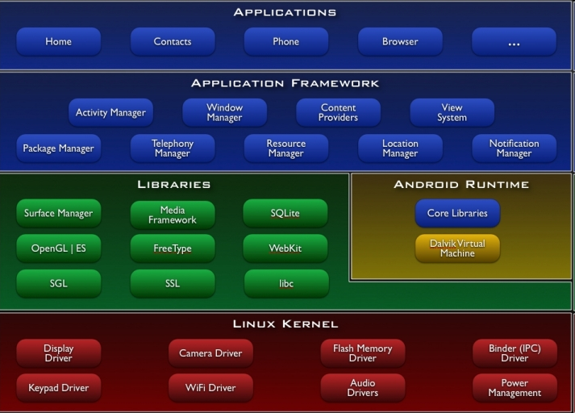
Android has many components

Slide 8
What makes up Android?
Activities
An activity is a core component of the Android platform. Each activity represents a task the application can do, often tied to a corresponding screen in the application user interface.
Content providers
Data stored on the device which can be used by multiple applications. The Android model makes it easy to make this data available to your own applications as well as others. An example is the content provider for contacts with the contained names, addresses, phone numbers, etc. available to any application.
Services
Tasks that run in background without the user’s direct interaction. An example would be music playing while the user is on another program. Another activity may bind to that service to switch tracks, all in the background.
Intents
System messages notifying activities of various events eg. memory stick inserted, file download completed, activity launched from menu. Intents can be created to give status reports such a how much of file is copied or warnings eg. left turn at next intersection.

Slide 9
Where we are?
Android Structure
Android IDE Installation
Hello World Example

Slide 10
What do we need?
Java Development Kit
Eclipse
Android SDK
Android Plug-in for Eclipse
Notes:
/* JDK is a pre-condition
When JDK is installed but Android SDK can’t found it, go to this folder
C:\Program Files\Java\jdk1.6.<version>\bin
And run java.exe
*/

Slide 11
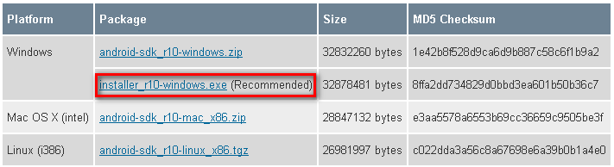
Android SDK
Visit http://developer.android.com/sdk/index.html
Download your DK version

Slide 12
Develop Android in C and C++
Android NDK (Native Development Tools): a toolset that lets you embed components that make use of native code in your Android applications
Allows you to implement parts of your applications using native-code languages such as C and C++.
provide benefits of reusability and increase speed in some cases.
http://developer.android.com/sdk/ndk/index.html

Slide 13
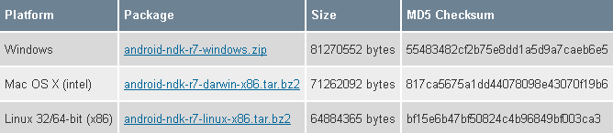
Android NDK
The NDK is designed for use only in conjunction with the Android SDK.
If you have not already installed and setup the Android SDK, please do so before downloading the NDK.

Slide 14
Android plug-in for Eclipse
Installed directly from Eclipse
https://dl-ssl.google.com/android/eclipse/
http://dl-ssl.google.com/android/eclipse/

Slide 15
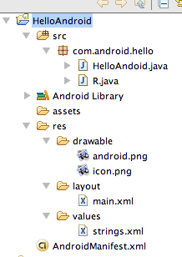
There is a common file structure for applications
code
Auto generated resource list
files
images
UI layouts
constants

Slide 16
Android Activity
“An activity is a single, focused thing that the user can do. Almost all activities interact with the user, so the Activity class takes care of creating a window for you in which you can place your UI with setContentView(View).”
http://developer.android.com/reference/android/app/Activity.html#ActivityLifecycle

Slide 17

Standard components form building blocks for Android apps
Notifications
Has life-cycle
Activity
Views
screen
Intents
App to handle content
Service
Background app
Like music player
manifest
ContentProviders
Other applications

Slide 18
Managing the Activity Lifecycle
An activity can exist in essentially three states:
Resumed
The activity is in the foreground of the screen and has user focus. (This state is also sometimes referred to as "running".)
Paused
Another activity is in the foreground and has focus, but this one is still visible. That is, another activity is visible on top of this one and that activity is partially transparent or doesn't cover the entire screen. A paused activity is completely alive (the Activity object is retained in memory, it maintains all state and member information, and remains attached to the window manager), but can be killed by the system in extremely low memory situations.
Stopped
The activity is completely obscured by another activity (the activity is now in the "background"). A stopped activity is also still alive (the Activity object is retained in memory, it maintains all state and member information, but is not attached to the window manager). However, it is no longer visible to the user and it can be killed by the system when memory is needed elsewhere.
Reference: http://developer.android.com/guide/topics/fundamentals/activities.html

Slide 19
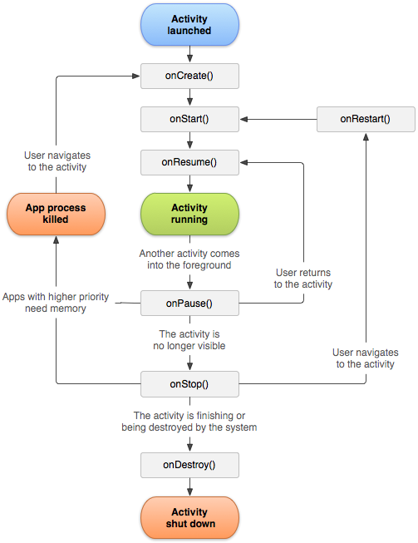
Activity Lifecycle

Slide 20
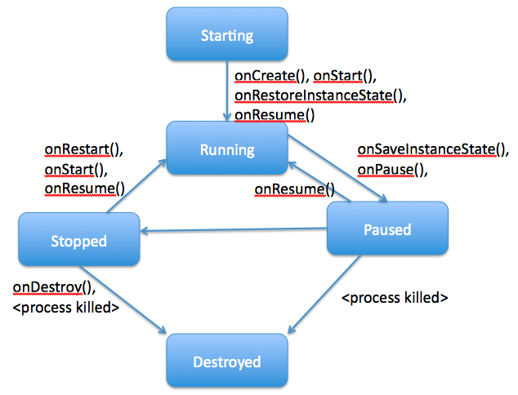
Activity State Diagram

Slide 21
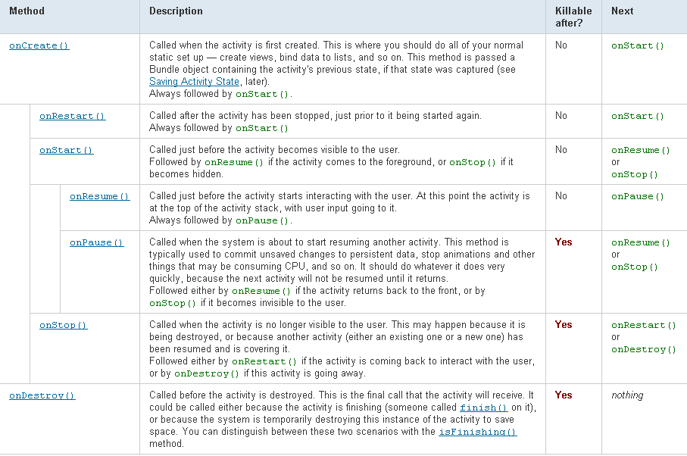

Slide 22
Where we are?
Android IDE Installation
Android Structure
Hello World Example

Slide 23
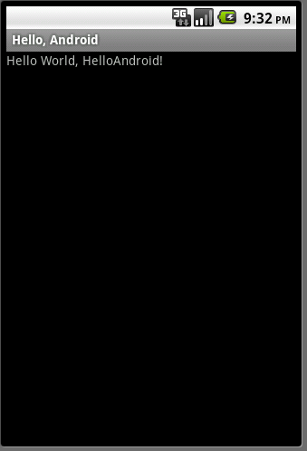
Goal
Create a very simple application
Run it on a real device
Run it on the emulator
Examine its structure

Slide 24
Google Tutorial
We will follow the tutorial at:
http://developer.android.com/resources/tutorials/hello-world.html
Start Eclipse (Start -> All Programs -> Eclipse)
Create an Android Virtual Device (AVD)
Create a New Android Project

Slide 25
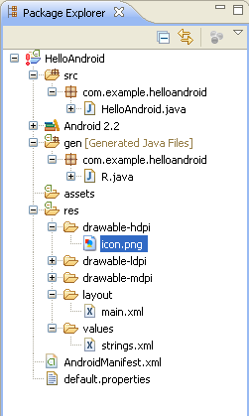
Package Content
All source code here
Java code for our activity
All non-code
resources
Generated Java code
Helps link resources to
Java code
Images
Layout of the activity
Strings used in the
program
Android Manifest

Slide 26
HelloAndroid.java
package com.example.helloandroid; import android.app.Activity; import android.os.Bundle; import android.widget.TextView; public class HelloAndroid extends Activity { /** Called when the activity is first created. */ @Override public void onCreate(Bundle savedInstanceState) { super.onCreate(savedInstanceState); TextView tv = new TextView(this); tv.setText("Hello, Android – by hand"); setContentView(tv); } }
Inherit from the Activity Class
Set the view “by hand” – from the program

Slide 27
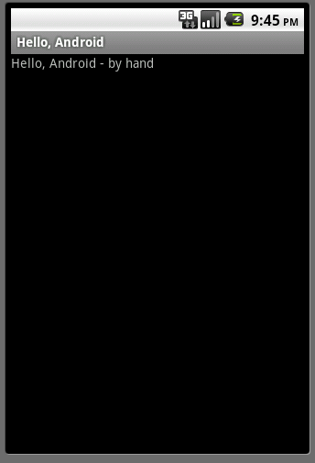
Run it!

Slide 28
/res/values/strings.xml
<?xml version="1.0" encoding="utf-8"?>
<resources>
<string name="hello">Hello World, HelloAndroid – by
resources!</string>
<string name="app_name">Hello, Android</string>
</resources>

Slide 29
/res/layout/main.xml
<?xml version="1.0" encoding="utf-8"?>
<LinearLayout xmlns:android="http://schemas.android.com/apk/res/android"
android:orientation="vertical"
android:layout_width="fill_parent"
android:layout_height="fill_parent"
>
<TextView
android:layout_width="fill_parent"
android:layout_height="wrap_content"
android:text="@string/hello"
/>
</LinearLayout>
Further redirection to /res/values/strings.xml

Slide 30
HelloAndroid.java
package com.example.helloandroid;
import android.app.Activity;
import android.os.Bundle;
public class HelloAndroid extends Activity {
/** Called when the activity is first created. */
@Override
public void onCreate(Bundle savedInstanceState) {
super.onCreate(savedInstanceState); setContentView(R.layout.main);
}
}
Set the layout of the view as described in the main.xml layout

Slide 31
/gen/R.java
package com.example.helloandroid;
public final class R {
public static final class attr {
}
public static final class drawable {
public static final int icon = 0x7f020000;
}
public static final class id {
public static final int textview = 0x7f050000;
}
public static final class layout {
public static final int main = 0x7f030000;
}
public static final class string {
public static final int app_name = 0x7f040001;
public static final int hello = 0x7f040000;
}
}

Slide 32
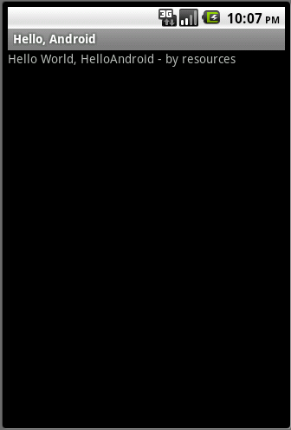
Run it!

Slide 33

Reference Book

Slide 34
Reading
Chapter 4,5 16: Murphy, M.,2009, Beginning Android, New York, Apress.

